Slide 1

Deal
Fit
AI-assisted brand partnership screening
for independent creators
AI recommends. The creator decides.
PASS FOR DEMONSTRATION
PRIVATE ALPHA NEXT
Team 008 • MBA ZG583
Notes:
[Sources]
- 01_Executive_Summary.md
- 02_Product_Strategy.md
- Visual on this slide was generated with Microsoft Copilot.
[/Sources]

Slide 2
THE PROBLEM
Every sponsorship pitch becomes a repeated manual decision
Creators must synthesize hard terms, soft fit and missing context under time pressure.
1
2
3
4
5
Email & DMs
Commercial terms
Fit & trust
Conflicts
Decision
Fragmented inbound pitches
Pay, deliverables, usage rights
Audience, values, reputation
Exclusivity and past deals
Accept, negotiate, decline or review
The product wedge is not a full CRM. It is the first-pass screening decision.
Notes:
[Sources]
- 02_Product_Strategy.md
- Appendix/Workflows/Current_State_Workflow.puml
[/Sources]

Slide 3
TARGET USER + JTBD
First wedge: creators who receive deals but manage them themselves
Design persona: Maya, a fictional lifestyle/wellness creator with ~75K followers.
Maya • independent creator
JOB TO BE DONE
50K–100K follower range
Lifestyle & Wellness niche
Receives multiple inbound offers
Uses email, DMs and spreadsheets
No dedicated full-service agent
“When I receive a sponsorship pitch, help me decide whether it deserves acceptance, negotiation, rejection or additional review—without rebuilding the evaluation from scratch.”
Functional
Trust
Business
Structure the decision
Show why + what is missing
Focus time on better opportunities
Notes:
[Sources]
- 02_Product_Strategy.md
[/Sources]

Slide 4
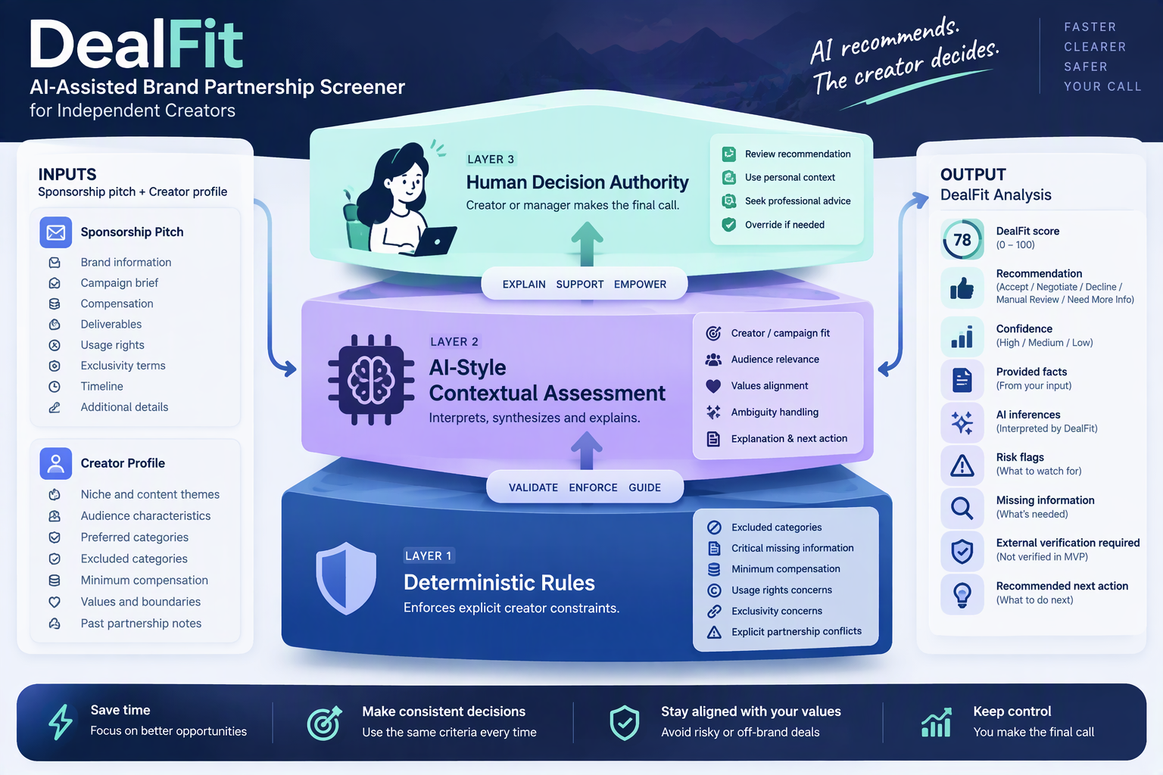
WHY DEALFIT + WHY AI
Rules handle hard constraints. AI-style logic handles context. Humans own the decision.
Notes:
[Sources]
- 05_Data_Model_Evaluation.md
- Appendix/Data_Model/Data_Model_and_Output_Schema.md
- Visual on this slide was generated with Microsoft Copilot.
[/Sources]

Slide 5
THE DEALFIT EXPERIENCE
From unstructured pitch to an explainable screening decision
1
2
3
4
Creator
Profile
New
Partnership
DealFit
Analysis
Creator
Decision
Reusable preferences
Pitch + structured terms
Score, risk, confidence
Accept, negotiate, override
Output: score • recommendation • confidence • provided facts • AI inferences • risk flags • missing information • verification requirements • next action
Notes:
[Sources]
- 04_UX_Workflow_Trust.md
- Appendix/Wireframes/Wireframes.md
- Prototype/DealFit_Prototype.html
[/Sources]

Slide 6
RESPONSIBLE AI BY DESIGN
Trust is part of the product—not a disclaimer added later
Creator Review Required
Facts ≠ Inferences
Score ≠ Probability
No recommendation is final
Evidence types are separated
Structured screening indicator
Uncertainty is visible
External evidence bounded
No automatic action
Missing information and confidence
Reputation, market rate, legal status
No contact, contract or payment
S03 proof point: INR 90,000 did not override the creator’s Gambling exclusion.
Notes:
[Sources]
- 07_Ethics_Governance_Risk.md
- Prototype/screenshots/06_Hard_Conflict.png
[/Sources]

Slide 7
V1 EVIDENCE
The first AI-built prototype worked—but was not product-correct
S04 • Missing compensation
S06 • Unclear exclusivity
12 / 12
Returned Negotiate / Medium instead of Manual Review / Low.
False positive existing-partnership conflict caused Decline.
scenarios executed
8 / 12
S07 • Weak fit
S11 • Values ambiguity
primary behaviors passed
66.7%
Enterprise software campaign incorrectly returned Accept / High.
Low values score did not change risk, confidence or decision.
4 PRIMARY FAILURES
Successful software execution ≠ correct product behavior.
Notes:
[Sources]
- Appendix/AI_Self_Evaluation/AI_Product_Self_Evaluation.md
- Appendix/Metrics/Metrics_and_Launch_Gates.md
[/Sources]

Slide 8
V2 CORRECTIONS
Observed failures became explicit product requirements
7 / 7 targeted regression behaviors passed.
SCENARIO
V1
V2
PRODUCT CHANGE
S04
Negotiate / Medium
Manual Review / Low
Critical missing fields
S07
Accept / High
Decline / High
Niche/domain comparison
S11
Negotiate / High
Manual Review / Medium
Values risk propagation
Regression result: Accept path preserved • safety corrections passed • genuine conflict retained
Notes:
[Sources]
- Appendix/AI_Self_Evaluation/AI_Product_Self_Evaluation.md
- Appendix/Metrics/Metrics_and_Launch_Gates.md
[/Sources]

Slide 9
HUMAN-IN-THE-LOOP PROOF
The creator can disagree—and DealFit treats the override as useful context
DEALFIT
Accept
High confidence • Score 75
CREATOR
Negotiate
Override: Yes
Reason
Personal relationship or context
No external action executed.
Notes:
[Sources]
- 09_Prototype_MVP.md
- Prototype/screenshots/04_Decision_Override.png
- Visual on this slide was generated with Microsoft Copilot.
[/Sources]

Slide 10
ROADMAP TO FIRST REVENUE
First prove recurring value—then test whether someone will pay
0
1
2
3
4
5
Prototype
Private Alpha
Creator Beta
First Paid Pilot
Creator Pro
Small Teams
Now
Month 1–2
Month 2–3
Month 3–5
Month 5–8
Month 8–12+
Paid-pilot hypothesis
INR 499 / month
Not validated market pricing. The first goal is one genuinely paying creator.
Notes:
[Sources]
- Appendix/Roadmap/Roadmap.md
- 06_Business_Economics_Scaling.md
[/Sources]

Slide 11
BEFORE A PAID PILOT
The prototype is demonstrable. Commercial readiness still requires evidence.
Real-user evidence
Product + technical controls
Launch blockers
Multiple creator niches
Measured screening-time change
Repeat usage and retention
Actual willingness to pay
Improved audience/fit logic
Secure authentication and storage
Retention and deletion policy
Recommendation consistency monitoring
Unsupported external claims
Unreliable creator exclusions
Legal advice boundary failure
Automatic action without approval
Current recommendation: IMPROVE AND VALIDATE FIRST
Notes:
[Sources]
- 07_Ethics_Governance_Risk.md
- Appendix/Risk_Note/Risk_Note.md
- Appendix/Metrics/Metrics_and_Launch_Gates.md
[/Sources]

Slide 12
LEADERSHIP RECOMMENDATION
Proceed to controlled validation—not scale.
PROVEN
• Coherent PM strategy
• Functional browser MVP
• Explainable human control
• Synthetic evaluation
• V1 defects identified
• V2 regressions passed
Launch a small Private Alpha with consenting creators. Invest next in real-user evidence, better fit logic and secure data handling—not broad feature expansion or proprietary-model development.
NOT YET PROVEN
• Real productivity gain
• Retention
• Willingness to pay
• CAC / LTV
• Product-market fit
AI recommends. The creator decides.
NEXT: PRIVATE ALPHA
Team 008
Notes:
[Sources]
- 01_Executive_Summary.md
- 10_Presentation_Plan.md
[/Sources]

